Slide 1
Risk Management
Ryan Miller

Slide 2
What is Risk Management?
Risk management is analysing risks and then either mitigating or controlling the risk.
“If you don’t actively attack risks, risks will actively attack you.”
- Tom Gilb

Slide 3
What is a Risk?
Wikipedia definition: “Risk is the possibility of losing something of value.”
A software risk is potential loss or issue that may or may not occur in the future of the project’s production or delivery.

Slide 4
What types of risk are of concern within a software project?
In my research I have discovered the following types of risks associated with software projects:
Product Size Risks.
Business Impact Risks.
Customer Related Risks.
Process Risks.
Technical Issues.
Technology Risks.
Development Environment Risks.
Staff Size and Experience Risks.

Slide 5
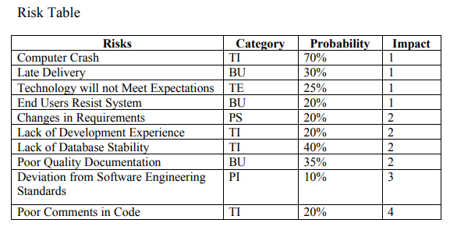
Risk Table Example:
Impact Values:
1 – Catastrophic
2 – Critical
3 – Marginal
4 – Negligible

Slide 6
How can these Risks be identified and their impact measured?
Risks may be identified by following a risk plan and identifying potential risks which may relate to your project.
Risks may measured by their influence and effect on other entities.
Experience will aid to improve these processes.

Slide 7
Any Questions?

